Slide 1
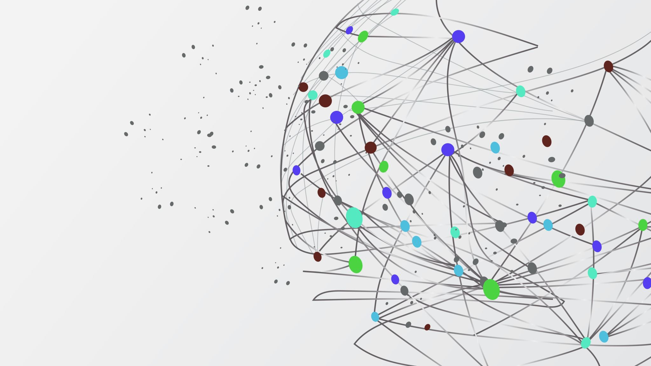
Sentiment Analysis of IMDB Movie Reviews
Kavi Sharma, Gunwoo Lee

Slide 2
Problem to Solve
Movie performance post box office
Translatable beyond the movie industry
Usage impacts movie studio execs, marketing organizations, directors, and consumers
Use of Convolutional Neural Networks for pattern recognition
Notes:
Initially we aimed our project at the movie industry. One of the largest open platform review website is IMDB. Our model is able to process user feedback and understand if a giving input sequence is positive or negative
But this model is easily translatable to any industry that utilizes consumer reviews for metrics. This could be websites like amazon, to see if a product is performing well, journalism to understand how its userbase like a particular piece, or the food industry to understand what parts of a meal a customer enjoyed or didn’t enjoy.
For this case in particular, it will influence Studio execs, the marketing team, directors, and consumers directly. This information could be harvested throughout the production process.
We will be using a Convolution Neural Network for this project

Slide 3
Introduction to CNN Models
Convolution Layer
MaxPooling Layer
Padding
Dropout
Flattening
Notes:
Convolution: Is done through matrix multiplication where a Kernel, typically 2x2 or 3x3 matrix scans across the input matrix one column and then one row at at time.
MaxPooling: Takes the output matrix from the convolution layer and multiples it against a 2x2 matrix where the highest dot product value in a feature is summarized. This allows the model to still capture important features while also reducing dimensionality of the matrix.
Padding: Padding is the inserting of zero’s on the parameter of the matrix, this allows the kernel to gain more insight by scanning the interior of the buffer zone.
Dropout: We randomly select neurons to zero at each step. This means that each update to the model is performed with a different “thinned” version. This ensures that the model does not correlate the noise in the training data as actual patterns.
Flattening: is the transformation of the processed matrix into a single column to be fed into the model for processing.

Slide 4
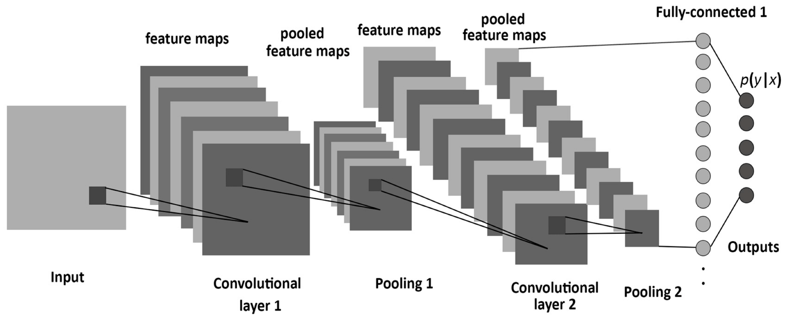

Slide 5
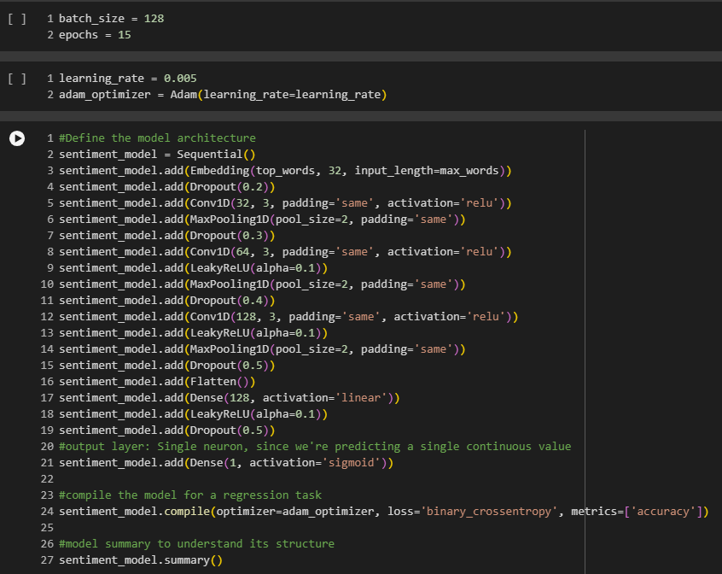
Sentiment Analysis Model

Slide 6
Introduction of the Keras IMDB Dataset
Training and Test sets contain 25,000 reviews
Restrictions to the data include keeping the top 5,000 used words and truncating/padding reviews to 500 words
Encoded as numerical lists based on the word’s frequency
X inputs correspond to individual sentiments
Y outputs correspond to whether the review is positive or negative
Notes:
Word Piece tokenizer was used here. This converts a text input and produces a numerical array based on the frequency of each word in the sequence.

Slide 7
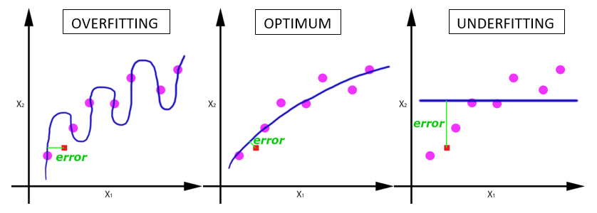
Results Analysis
Notes:
Overfitting = is defined when the model can not generalize and fits too closely to the train data but can not create accurate predictions on test data.
The model is overly complex and the model is learning from the noise within the training data
Dataset contains large amounts of irrelevant information
Training data is too small and does not contain enough samples to represent all possible input values
Underfitting = occurs when the model cannot determine any meaningful relationship between the input and output data.
Underfit models experience high bias as they produce inaccurate results for both the training and test datasets, while overfit models experience high variance. This is due to the models performing well on the training set but is unable to pivot that towards unseen data.

Slide 8
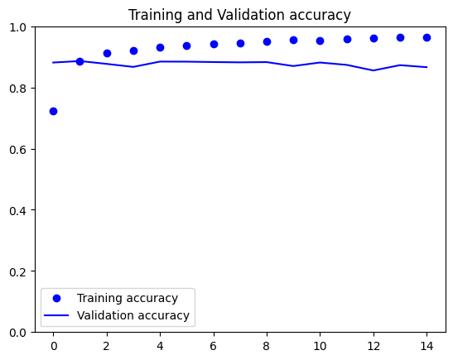
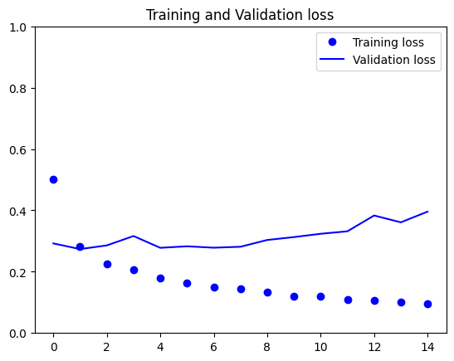
Results Analysis Cont.

Slide 9
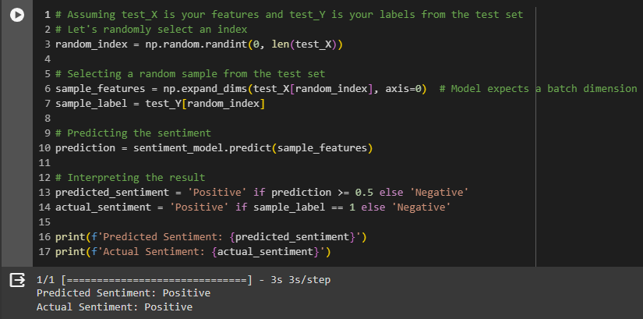
Sentiment Analysis Validation

Slide 10
Previous Attempt
Rating prediction model using Movie Genres as an input
Production companies can produce better movies
Users would have a basis for whether a movie would perform well or not

Slide 11
Data Sourcing and Cleaning
Sourced from IMDB open-source databases
Combined the Movie Rating and Movie Genre Databases and match entries based on Unique ID
Removed
Duplicate entries
Production start/end year
All entries not type Movie
Entries less than 60 mins and greater than 180 mins
Non-English movies

Slide 12
Pre-processing
151,183 entries post-cleaning
Data was One-Hot encoded
Training and Test data sets were created using an 80/20 random split
X input correlated to Genres
Y output correlated to Average Rating

Slide 13
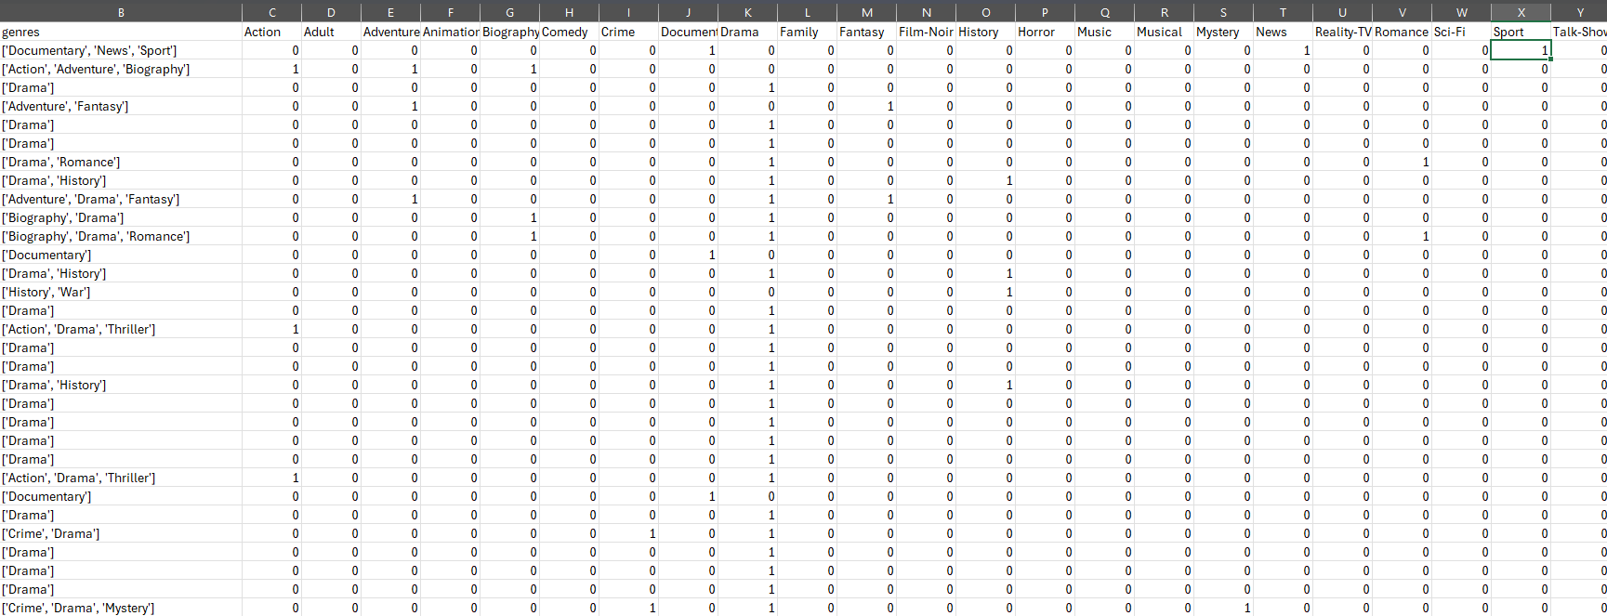
One-Hot Encoding
Notes:
The columns are labeled with every possible class (in this case we have 26 classes for the 26 genres)
A 1 or a 0 represents the presence of a genre in a particular Unique ID
This transforms textual data into a binary format so that the model can pull insight

Slide 14
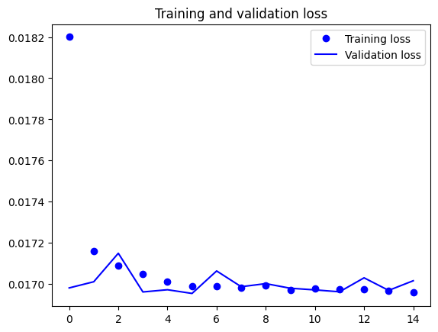
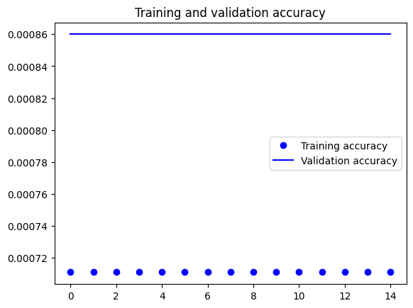
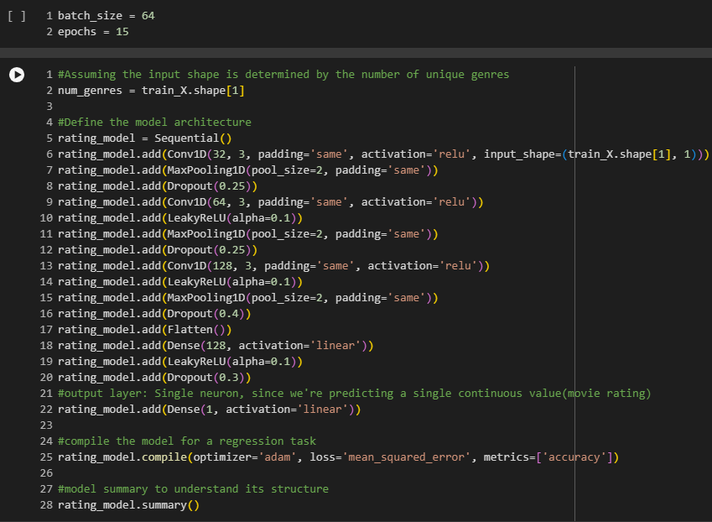
Rating Model/Results

Slide 15
Shortcomings
Insufficient correlation between Genre and Average Rating
Additional input variables needed
Directors
Main Actors
Movie Budgets
Gross Revenue

